Slide 1
Stroke-by-Stroke Evolution of Visual Artworks

Slide 2
Introduction
The objective is to develop an artwork from an initial sketch to final painting by constructing a stroke-by-stroke sequence as if the art is drawn by a human.
Interactive Art
Art Authentication
Stroke Pattern Analysis
Restoration
Art completion
Style/stroke based classification/tagging
Art Education and Training
Virtual and AR Experiences

Slide 3
Introduction
Why not pixel-space?
Captures the artist's intent and reflects how the artwork was created
Robust to variations and noise
Stroke-by-stroke analysis enables Guided Restoration, Drawing process, experience
Preserves artistic traditions
Challenges:
How do we represent and extract stroke level information for complex art
What is the plausible way to construct the sequence order of strokes that mimic a drawing process?

Slide 4
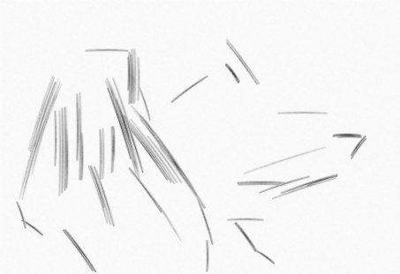
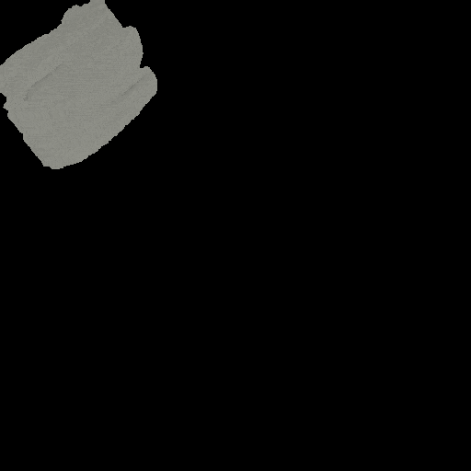
Related works
Limited to line art images with clearly defined lines or curves, excluding those with shading, texture, or complex geometrics
Computationally expensive
The method adopts an ETF-based approach, which lacks an inherent sequence
Doesn’t support complex vector curves
Difference between the generated image and the target is minimized using an L2 loss
Constrains the network input size to 128x128 images.
Doesn’t support complex vector curves

Slide 5
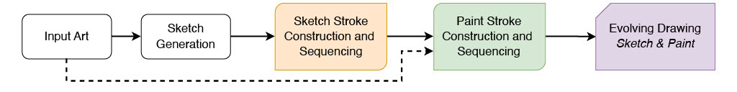
Method
Motivation
Artists frequently rely on principles from Gestalt psychology, such proximity, similarity, continuity, and closure, to guide their drawing processes. These concepts also play a crucial role in perceptual grouping during segmentation tasks. Inspired by this, we present sketch & paint.
Outline of the proposed method for sketch and paint

Slide 6
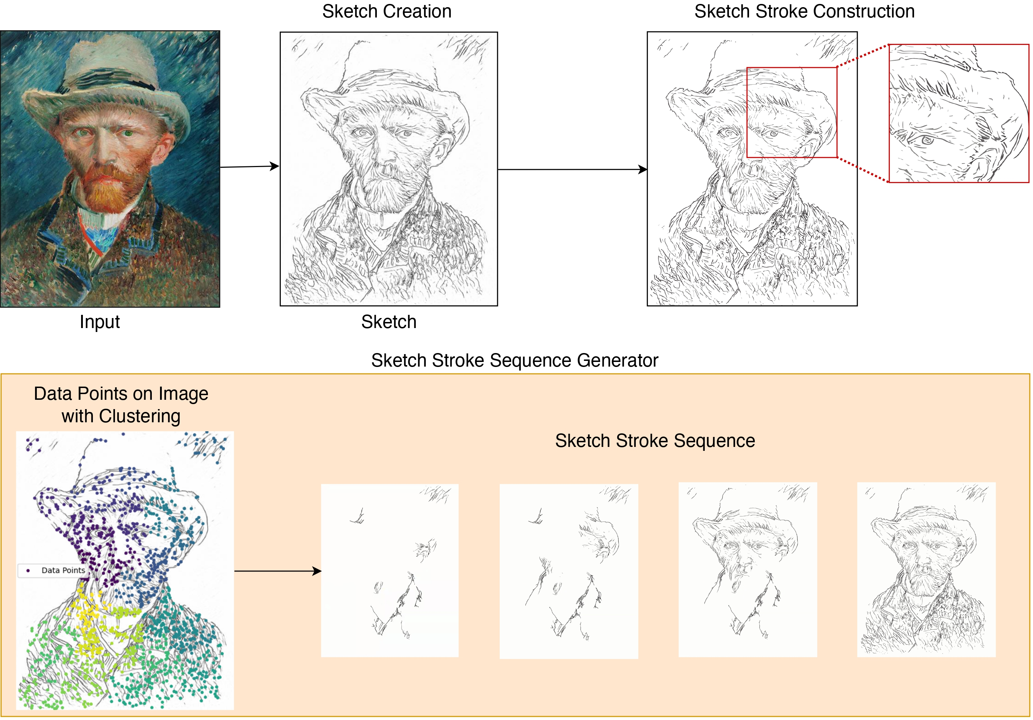
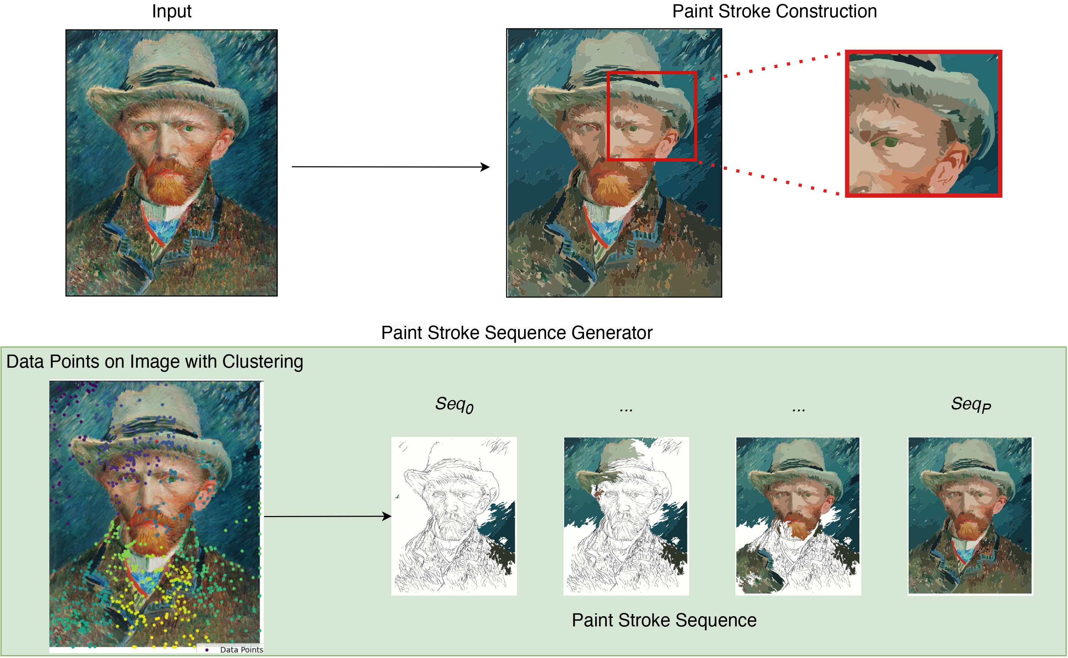
Method
Framework for sketch stroke construction and sequencing
Framework for paint stroke construction and sequencing

Slide 7
Results
Wiki Art
Line Art
Face Images
Photographic Images

Slide 8
Future Work
We will explore a weighted energy function that integrates additional parameters to enable the use of Graph Neural Networks (GNNs), Reinforcement Learning (RL), and cluster-based methods.
Additional parameters include proximity , collinearity/continuity , complexity of stroke, representation of curve, hierarchy, similarity (degree), symmetry (degree), direction of curve, position of curve w.r.t. to cluster.
Decomposing Color Patches into Brush Strokes
We can define brush size and color parameters, then learn to do patch filling
Blending our proposed method and pretrained RL based rending methods for paint stroke filling.
Exploring a supervised DL method for stroke sequence prediction based on our existing sketch & paint sequencing
Input: sequence of stroke images output: sequence token.
Simplify the problem by focusing on portrait or object-specific artworks that allow for manual reasoning of the sequencing (Global sequencing).
head->face outline->eyes->ears->nose->mouth->filling.
key points sequence or a scene with semantic attribute graph or visual relational graph.
Adopting preference-based mechanism over multiple rule based methods.

